Slide 1
PHP Programming with MySQL
Day 4

Slide 2
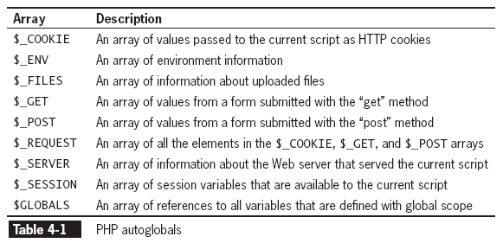
Using Autoglobals
Autoglobals are predefined global arrays that provide information about server, environment, and user input
What is the difference between GET and POST methods?

Slide 3
Using Autoglobals
Autoglobals are associative arrays
To access the values in an associative array, place the element’s key in single or double quotation marks inside the array brackets. (the following example displays the SCRIPT_NAME element of the $_SERVER autoglobal) $_SERVER["SCRIPT_NAME"];//displays the path and name of the current script

Slide 4
Building XHTML Web Forms
Web forms are interactive controls that allow users to enter and submit data to a processing script
A Web form is a standard XHTML form with two required attributes in the opening <form> tag:
Action attribute: Identifies the program on the Web server that will process the form data when it is submitted
Method attribute: Specifies how the form data will be sent to the processing script

Slide 5
Adding an action Attribute
The opening form tag requires an action attribute
The value of the action attribute identifies the program on the Web server that will process the form data when the form is submitted
<form action="http://www.example.com/ HandleFormInput.php">

Slide 6
Adding the method Attribute
The value of the method attribute must be either “post” or “get”
The “post” method embeds the form data in the request message
The “get” method appends the form data to the URL specified in the form’s action attribute
When a Web form is submitted using the “post” method, PHP automatically creates and populates a $_POST array; when the “get” method is used, PHP creates and populates a $_GET array

Slide 7
Adding the method Attribute
Form fields are sent to the Web server as a name/value pair
The name portion of the name/value pair becomes the key of an element in the $_POST or $_GET array, depending on which method was used to submit the data
The value portion of the name/value pair is populated by the data that the user enters in the input control on the Web form
When submitting data using the “get” method, form data is appended to the URL specified by the action attribute
Name/value pairs appended to the URL are called URL tokens

Slide 8
Adding the method Attribute
The form data is separated from the URL by a question mark (?)
the individual elements are separated by an ampersand (&)
the element name is separated from the value by an equal sign (=).
Spaces in the name and value fields are encoded as plus signs (+)
all other characters except letters, numbers, hyphens (-), underscores (_) and periods (.) are encoded using a percent sign (%) followed by the two-digit hexadecimal representation of the character’s ASCII value
(the following code shows three form elements submitted to the process_Scholarship.php script)
http://www.example.net/process_Scholarship.php?fName=John&lName=Smith&Submit=Send+Form

Slide 9
Adding the method Attribute
Limitations of the “get” method for submitting form data
Restricts the number of characters that can be appended to a single variable to 100
The form values are appended to the URL in plain text, making a URL request insecure
Advantage of the “get” method for submitting form data
Passed values are visible in the Address Bar of the browser and can be bookmarked
What are the advantages of the POST method?

Slide 10
Processing Form Data
A form handler is a program or script that processes the information submitted from a Web form
A form handler performs the following:
Verifies that the user entered the minimum amount of data to process the form
Validates form data
Works with the submitted data
Returns appropriate output as a Web page

Slide 11
Retrieving Submitted Data
The PHP script that processes the user-submitted data is called a form handler.
The values stored in the $_POST array can be accessed and displayed by the echo statement as shown below:
$firstName = $_POST['fName'];
$lastName = $_POST['lName'];
secho "Thank you for filling out the scholarship form, ".$firstName." ".$lastName . ".";

Slide 12
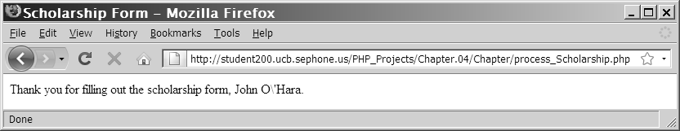
Handling Special Characters
Magic Quotes automatically add a backslash character to any single quote, double quote, or NULL character contained in form data that a user submits to a PHP script
Figure 4-4 Form input string with magic quotes

Slide 13
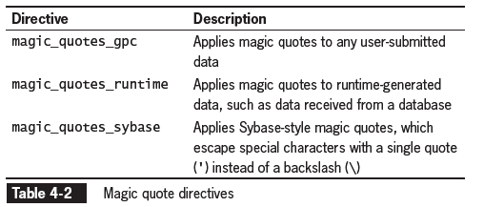
Handling Special Characters

Slide 14
Handling Special Characters
The addslashes() function adds a backslash before a single or double quote or a NULL character in user input (if magic quotes is disabled, this is the alternative to escape a character before saving to a text file or database)
The stripslashes() function removes a backslash before a single or double quote or NULL character in user input (if magic quotes is enabled, this is required before outputting a string with the echo statement)

Slide 15
Handling Submitted Form Data
It is necessary to validate Web form data to ensure PHP can use the data
The optimal way to ensure valid form data is only allow the user to enter an acceptable response
Examples of data validation include verifying that
the user did not leave any required fields blank
an e-mail address was entered in the correct format
the user did not exceed the word limit in a comment box

Slide 16
Determining if Form Variables Contain Values
When form data is posted using the “post” or “get” method, all controls except unchecked radio buttons and checkboxes get sent to the server even if they do not contain data
The empty() function is used to determine if a variable contains a value
The empty() function returns FALSE if the variable being checked has a nonempty and nonzero value, and a value of TRUE if the variable has an empty or zero value

Slide 17
Validating Entered Data
Validating form data refers to verifying that the value entered in a field is appropriate for the data type that should have been entered
The best way to ensure valid form data is to build the Web form with controls (such as check boxes, radio buttons, and selection lists) that only allow the user to select valid responses
Unique information, such as user name, password, or e-mail must be validated

Slide 18
Validating Numeric Data
All data in a Web form is string data and PHP automatically converts string data to numeric data if the string is a number
The is_numeric() function is used to determine if a variable contains a number
The round() function can be used to a numeric variable with an appropriate number of decimal places

Slide 19
Validating String Data
Regular expression functions are some of the best tools for verifying that string data meets the strict formatting required for e-mail addresses, Web page URLs, or date values
The stripslashes() function removes the leading slashes for escape sequences
The trim() function removes any leading or trailing white space from a string

Slide 20
Handling Multiple Errors
When processing a Web form, it is best to track any errors on the form during processing and then redisplay the form for the user to correct all the errors at one time

Slide 21
Redisplaying the Web Form
A sticky form is used to redisplay the form with the controls set to the values the user entered the last time the form was submitted
The following syntax illustrates how to use the value attribute to display previous submitted values in sticky form:
<p>First Name: <input type="text" name="fName" value="<?php echo $firstName; ?>" /></p>

Slide 22
Exercise
Create an online quiz on any topic with at least 10 questions.
The answers input fields should include a variety of HTML form elements:
Text boxes
Text area
Checkboxes
Radio buttons
Select boxes
Implement automated checking and grading of the quiz answers.
Display the errors inline.
Calculate and display the grade.
Let a fellow student test your quiz.
Present your quiz to the class and describe what issues you encountered during development, and how you solved them.

Slide 23
Emailing the Web Form
The mail() function is used to send an e-mail message containing form data in PHP
The basic syntax for this function is
mail(recipient(s), subject, message)
The Address Specifier defines the format of the e-mail addresses that can be entered as the recipient argument
Plain e-mail address: jdoe@example.net
Recipients name and e-mail address: Mary Smith <mary.smith@example.com>

Slide 24
Emailing the Web Form
The subject argument of the mail() function must include only plain text with no XHTML tags or character entities unless a special MIME format is used
The message argument of the mail() function is a text string that must also be in plain text
A fourth, optional additional_headers argument can include headers that are standard in most e-mail editors – From, Cc, Bcc and Date.

Slide 25
Emailing the Web Form
With the additional_headers argument
Each header must be on its own line
Each line must start with the header name, followed by a colon, a space, and the value of the header element
Date: Fri, 03 Apr 2009 16:05:50 -0400
From: Linda M. Jones linda@jones.example.com
CC: Mary R. Jones <mary@jones.example.com>
A successful e-mail message returns a value of TRUE

Slide 26
Creating an All-in-One Form
A two-part form has one page that displays the form and one page that processes the form data
For simple forms that require only minimal processing, it’s often easier to use an All-in-One form—a single script used display a Web form and process its data

Slide 27
Validating an All-in-One Form
It uses a conditional to determine if the form has been submitted or if it is being viewed for the first time
The isset() function is used to determine if the $Submit variable has been set
if (isset($Submit)) {
// Validate the data
}
The argument of the isset() function is the name assigned to the Submit button in the Web form

Slide 28
Redisplaying the Web Form
If the submitted data did not pass all validation checks or no data has been entered, the All-in-One form will display the Web form, for the user to enter data for the first time or re-enter data that did not pass validation
if (isset ($_POST['Submit'])) {
// Process the data
}

Slide 29
Using a Web Page Template
A Web template is a single Web page that is divided into separate sections such as
Header
Button Navigation
Dynamic Content
Footer
The contents of the individual sections are populated using include files

Slide 30
Using Text Hyperlinks for Navigation
When the user clicks on a text hyperlink the contents that display in the dynamic data section of the index.htm (home page) are replaced by the contents referenced by the href attribute
A name/value pair is appended to the index URL (this attribute and value will be referenced in the dynamic data section of the index.php file)
The name is user defined
The value is user defined
<a href = "index.php?page=home_page">Home</a>

Slide 31
Using Form Image Buttons for Navigation
Buttons must be enclosed by a opening and closing <form> tag
<input type = "image" src = "home.jpg" name = "home" style = "border:0" alt= "Home" />
x- and y- coordinates are sent in the form “Button.x” and “Button.y” where “Button” is the value of the name attribute (home)
In PHP, the periods are replaced by underscores for the $_GET or $_POST array indexes
The $_GET and $_POST array would have two elements “home_x” and “home_y”

Slide 32
Displaying the Dynamic Content
The $_REQUEST autoglobal can be used to access the results from form data sent using either the “get” or “post” methods
The syntax to save the value of the page attribute to a variable is shown below:
$displayContents = $_REQUEST["page"];
The dynamic content section of the index.php file will contain the code to determine which content page to display

Slide 33
Displaying the Dynamic Content
if (isset($_GET['page'])) {
switch ($_GET['page']) {
case 'About Me':
include('inc_about.html');
break;
case 'home'://display the default page
include('inc_home.html');
break;
default:
include('inc_home.html');
break;
}
}

Slide 34
Summary
PHP includes various predefined global arrays, called autoglobals or superglobals, which contain client, server, and environment information that you can use in your scripts
Web forms are standard XHTML Web pages with interactive controls that allow users to enter data
The <form> tag requires an action attribute to identify the script that will process the submitted data and a method attribute to identify whether the data will be sent using the “get” or “post” method
The $_POST autoglobal contains data submitted from a form using the “post” method; the $_GET autoglobal contains data submitted from a form using the “get” method or through a hyperlink

Slide 35
Summary
Web forms may have two components: the data entry form page and the data processing script
If Magic Quotes is enabled, the PHP scripting engine inserts an escape character before a single quotation mark, double quotation mark, or NULL character in any submitted form data
Magic quotes may be enabled for a PHP server
The addslashes() function inserts an escape character before a single quotation mark, double quotation mark, or NULL character in a string
The stripslashes() function removes the escape character before a single quotation mark, double quotation mark, or NULL character in a string
The first step in processing form data is to validate the input

Slide 36
Summary
The empty()function determines if the entered value has an empty or zero value
The is_*() family of functions determines if the entered value is of the required data type
Regular expressions determine if an entered string value is formatted correctly for the required type of entry
The user should be notified of all errors in the values entered into the form
Sticky forms are forms that redisplay after an error has been found
The fields in a sticky form are populated with the values the user entered previously.
Advanced escaping from XHTML is a convenient way to display XHTML code within a PHP code block

Slide 37
Summary
The mail() function is used to send mail from PHP; it can be used to send form data via e-mail when the form has been successfully completed and validated
All-in-One Web forms combine the data entry form page and the data processing script into a single script
The isset() function determines if the entered value has been initialized (or set)
URL tokens use the “get” method and additional data appended to the URL to submit information to a PHP script
Web templates combine static elements and a dynamic content section within a Web page
Web templates can use the include() function within a conditional or switch statement to display dynamic content from different include files within the same section of the template

Slide 38
Exercise
Create a all-in-one page with a form that calculates an employee’s weekly gross salary, based on the number of hours worked and an hourly wage that you choose. The form should contain input fields for the week dates, and the number of hours.
Create a PHP form handler that computes the weekly paycheck amount. All hours above 40 are overtime and should be paid at 150% rate.
Store the weekly paycheck data in $_SESSION and display the paycheck history from the previously submitted input.
To increase the complexity, add taxes and input validation.

